Slide 1
Multiphysics Modelling for Four States of Matter
Stephen Millmore
Laboratory for Scientific Computing

Slide 2
Outline
What do we mean by multiphysics?
Methods for multiphysics
Challenges of multiphysics modelling
Multiphysics approaches

Slide 3
Multiphysics Modelling for Four States of Matter
This course utilises the physics and numerical methods from Numerical Methods for Compressible Fluid Dynamics and Simulation of Matter Under Extreme Conditions, and considers how we can allow for multiple materials in a single computational domain
The challenges in achieving this are largely in how we treat the boundaries between materials, whilst retaining the ability to work on a regular Cartesian mesh
Six lectures and six practicals
As is probably now expected, these will be recorded
And similarly, the practical work has additional time scheduled for after exams, and may be helpful when choosing research projects

Slide 4
Multiphysics Modelling for Four States of Matter
The Lectures:
Multiphysics Modelling for Four States of Matter
Level set methods
Ghost fluid methods (part 1)
Diffuse interface methods
Ghost fluid methods (part 2)
Cavitation, surface tension and fracture

Slide 5
Outline
What do we mean by multiphysics?
Methods for multiphysics
Challenges of multiphysics modelling
Multiphysics approaches

Slide 6
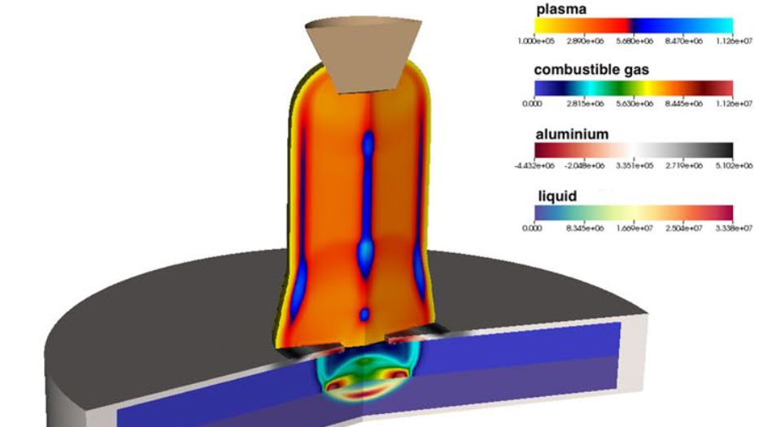
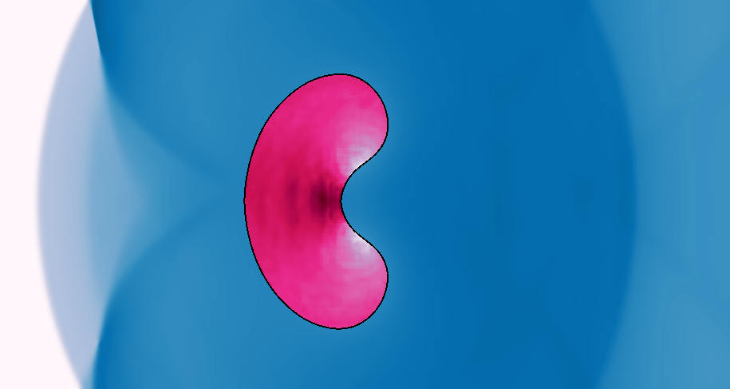
What do we mean by multiphysics?
Any system for which a mathematical or computational representation requires more than one material model for a complete description of its physics
Air
Quite a broad (and poorly defined) description
It ranges from the interaction of two different ideal gases
Or it could involve all four states of matter and include reactive chemistry of one or more materials
Helium
Both of these cases require that the interaction of two or more materials is modelled
This interaction forms the key challenge of multiphysics methods

Slide 7
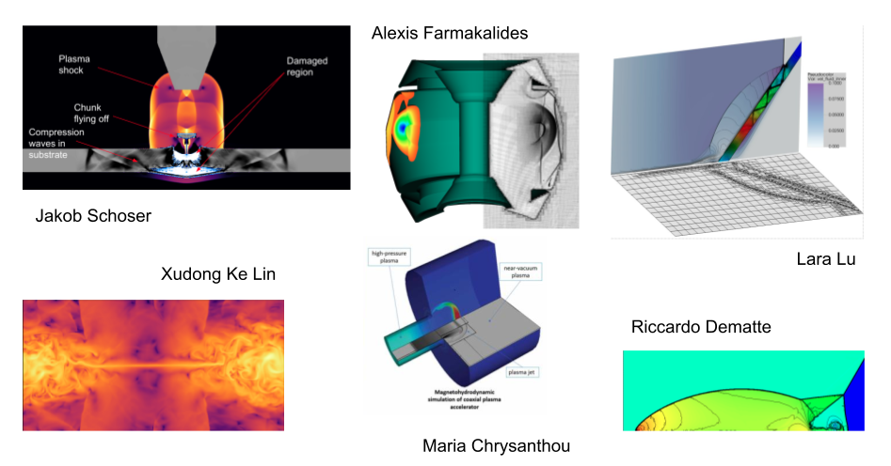
Multiphysics examples
Plasma-solid interaction
Air-solid interaction
Electron-ion interaction
Plasma-vacuum interaction

Slide 8
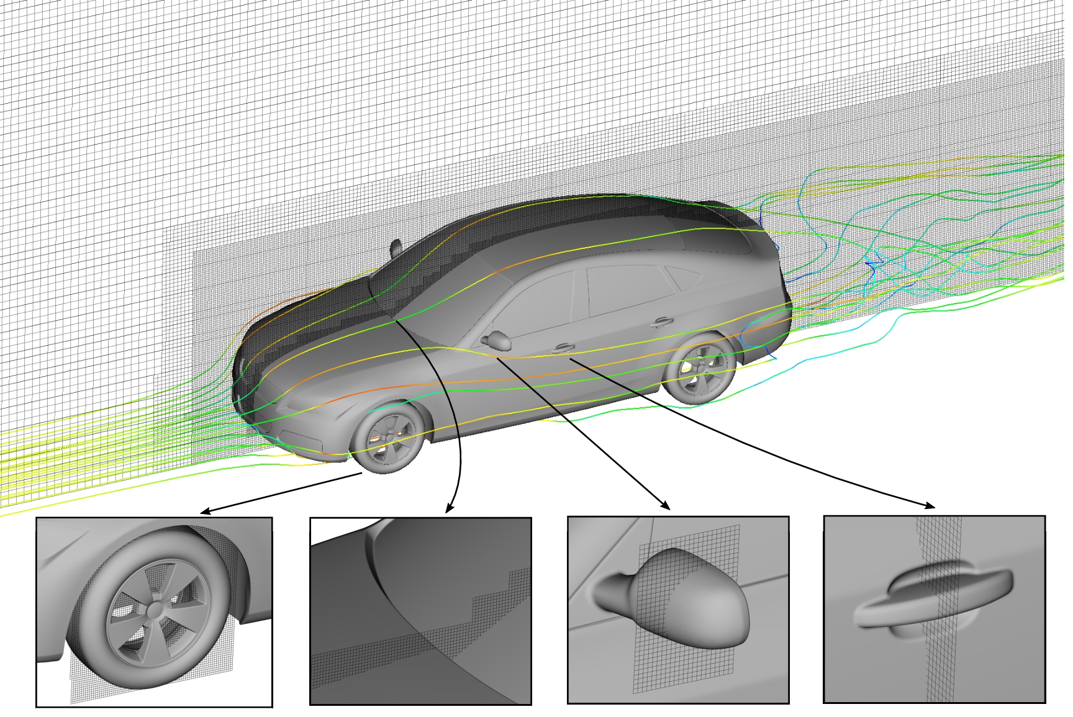
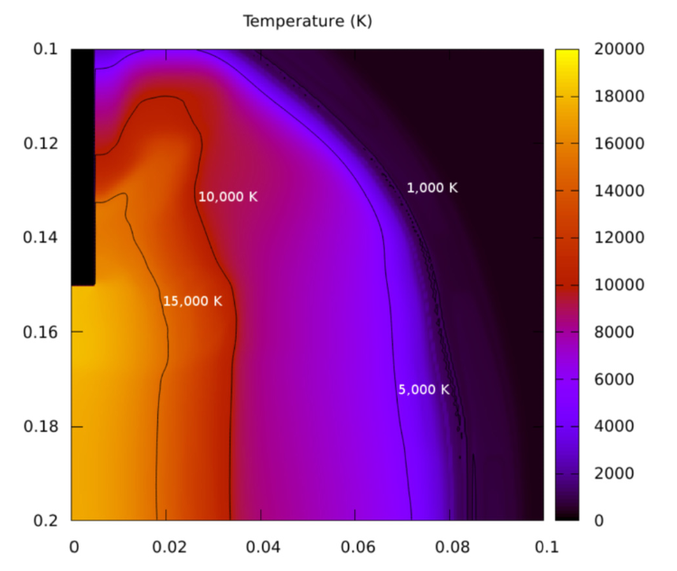
Material interactions without multiphysics
Sometimes we have a material interface but don’t need multiphysics methods
The cut cell methods we have covered are a clear example of this
In our lightning model, we have the transition from gas to plasma
Whilst technically multiphysics, our EoS means we don’t need to model the interactions that take place

Slide 9
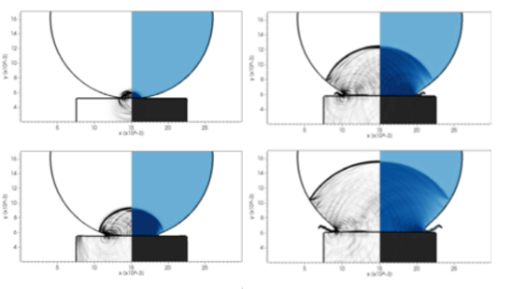
Multiphysics and two-way interaction
When droplets impact surfaces at high speed, the jet forms much later than theoretical models suggest
The droplet impact sends shockwaves through the metal
The waves in the metal move faster than waves in the water and air
This alters the state of what theoretically is “ambient conditions”
As a result, the jet happens later, and damage to metal increases

Slide 10
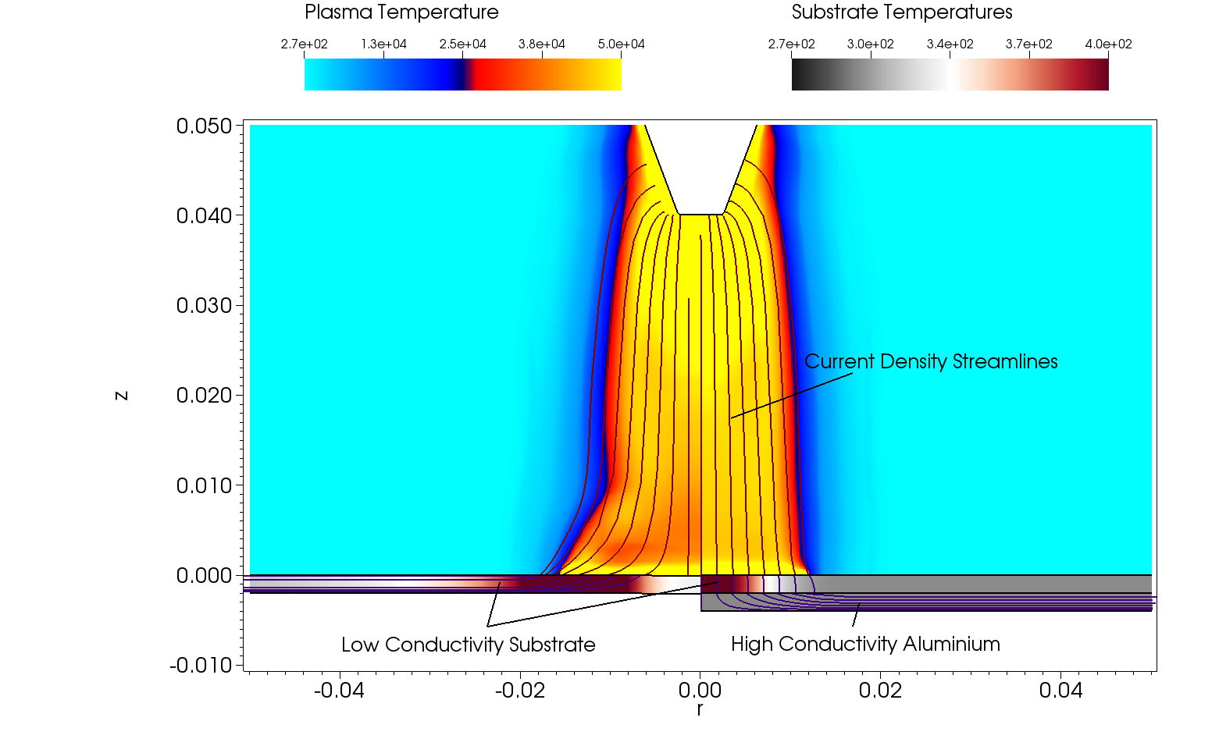
Multiphysics and two-way interaction
Lightning attachment to an aircraft substrate is governed by their interaction
Current wants to take the shortest path through the substrate
Where it attaches, it damages the substrate, making it less conductive
This alters the most favourable path; the arc structure can change
And then a new part of the substrate is exposed to high current

Slide 11
Outline
What do we mean by multiphysics?
Methods for multiphysics
Challenges of multiphysics modelling
Multiphysics approaches

Slide 12
Numerical multiphysics simulations
These lectures consider the tools required for numerical simulation of multiphysics situations
We focus on Eulerian ‘single-code’ models, after discussing the available methods
Even within this restriction, there is no single ‘best technique’ to deal with multiphysics behaviour
The choice of method depends on the physics of the situation and how the materials interact
Development of these methods is still an active research area
It may even be that multiple multiphysics models are used (multi-multiphysics?)

Slide 13
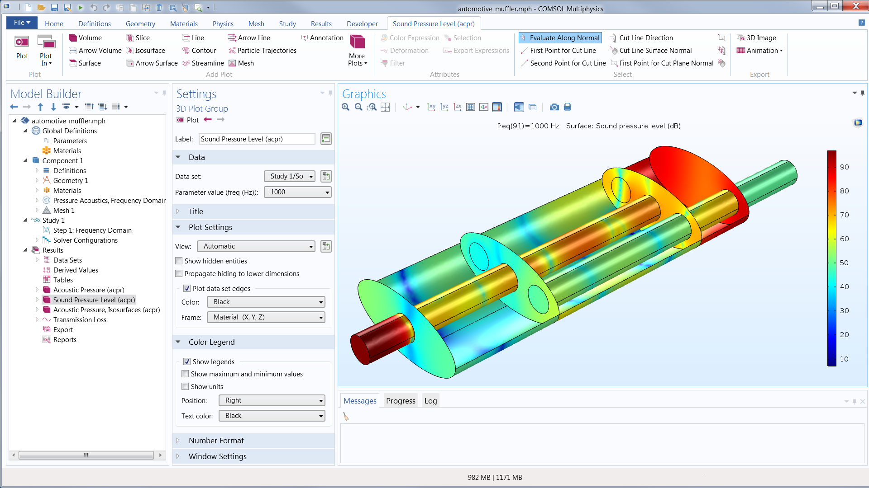
Techniques to model multiple materials
Each material is modelled using a separate code (or code instance) on its own mesh
Source:
COMSOL Multiphysics
This is the typical approach when using commercial ‘off-the-shelf’ packages
The co-simulation approach

Slide 14
Techniques to model multiple materials
Each material is modelled using a separate code (or code instance) on its own mesh
Advantages:
Simplicity – no need to write code
Speed of implementation
Disadvantages:
Passing information between models is difficult, and can introduce error
Especially for two-way feedback
If physics is missing from the code, it can be hard (or impossible) to add
Lack of flexibility of your own code

Slide 15
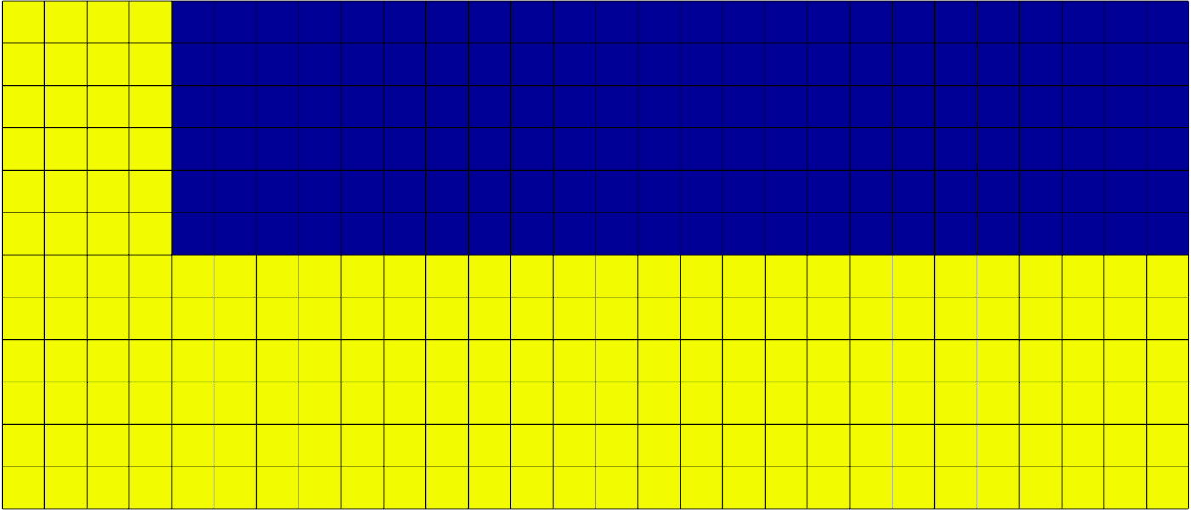
Techniques to model multiple materials
Each material has its own Lagrangian mesh fitted to its own geometric configuration
Source:
LLNL BLAST
This does, of course, require you to start with Lagrangian modelling

Slide 16
Techniques to model multiple materials
Each material has its own Lagrangian mesh fitted to its own geometric configuration
Advantages:
An interface between materials is captured at the same time as meshing
Interactions between materials can then be easily modelled
These methods can be very accurate (high-order)
Disadvantages:
All the disadvantages of Lagrangian meshes remain
Stability can be harder to achieve
Does not deal with the case where we might have a physical transition region between materials

Slide 17
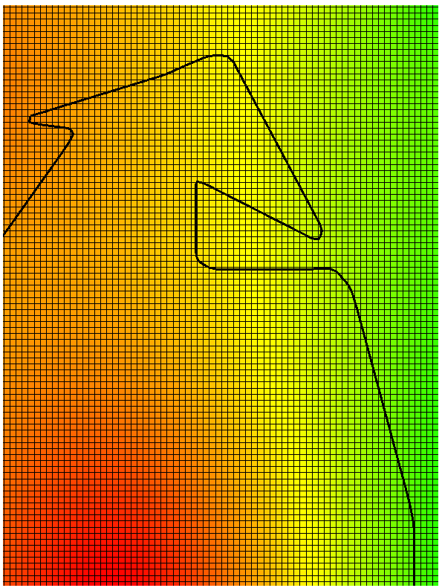
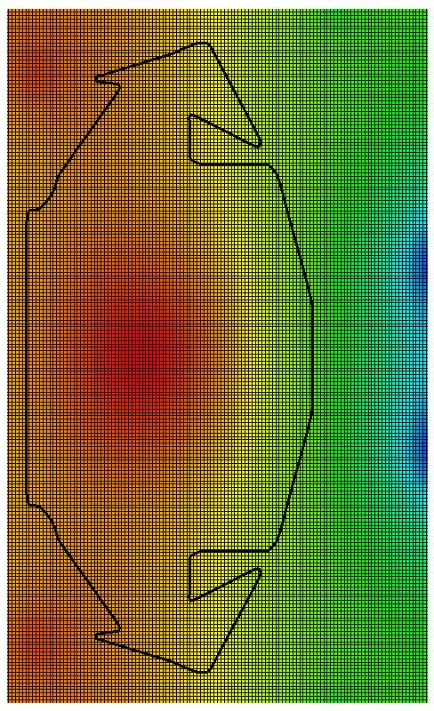
Techniques to model multiple materials
All materials are represented on a single mesh, possibly with multiple materials existing in a given region
Allows for an Eulerian description of material evolution
Any material interfaces are referred to as embedded
Source:
COMSOL Multiphysics

Slide 18
Techniques to model multiple materials
All materials are represented on a single mesh, possibly with multiple materials existing in a given region
Advantages:
Interactions can be modelled between materials, either with a distinct interface or a transition region
Complex interface structures are only limited by mesh resolution
And uniform meshes can be used; simple to generate and no remeshing
Disadvantages:
Some technique to model where materials exist is now needed (more equations to solve)
There can be accuracy issues at boundaries
Not yet common in commercial codes – you’ll have to write these methods yourself

Slide 19
Outline
What do we mean by multiphysics?
Methods for multiphysics
Challenges of multiphysics modelling
Multiphysics approaches

Slide 20

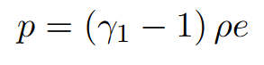
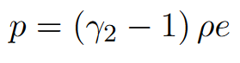
What are the challenges of multiphysics modelling
To illustrate the challenges, we consider a simple situation – two ideal gases
As a wave passes through one material, it will eventually interact with the interface
Our model needs to capture any waves transmitted, and any waves reflected when this interaction occurs
This interaction will also give velocity to the interface

Slide 21

Why are these challenges to model?
It is worth considering why modelling the interaction between two materials is actually difficult
To do this, we consider the simplest dynamic test case we can – the entire domain moving with a single velocity
The physics of the material interface here is simple, it should also move with the material velocity
So a simple assumption might be to have equation of state parameters being a function of space; governed by this velocity

Slide 22
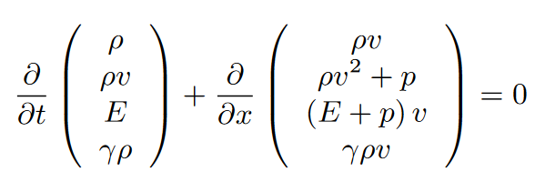
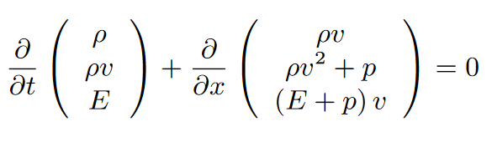
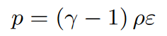
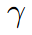
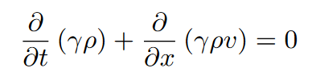
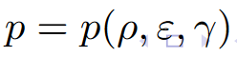
Why are these challenges to model?
The underlying evolution equations are straightforward; for the fluid variables, we just need the compressible Euler equations
If the equation of state is spatially varying, this introduces another variable within our model, and thus we need an evolution equation to describe it
This is simple, since it behaves much like an advective tracer
We still have an ideal gas equation of state to close this system
But since is a variable, we have

Slide 23
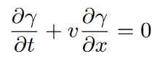
Why is this the equation for a material interface?
A material interface in thermodynamic equilibrium is defined by having a constant pressure and velocity, and a jump in density
A contact discontinuity is defined by having a constant pressure and velocity, and a jump in density
From previous lectures, a contact discontinuity moves at the speed of the material, i.e.
When a wave interacts with an interface, we assume (for now) that there is no change in phase, or change in material, of either of the two initial states, i.e. there is no mass transfer over the interface
Again, the only wave for which this property holds is the contact discontinuity

Slide 24
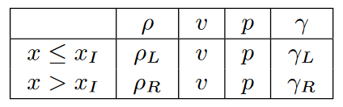
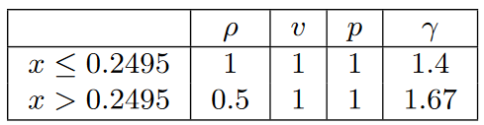
Testing this approach
The full initial data for a moving contact discontinuity is
Two different materials at constant pressure (without thermal diffusion) should simply move at velocity v without generating additional waves
Numerical diffusion of density is expected, as with any contact discontinuity
We will also see this diffusion in the equation of state parameter, however, since we would physically expect some mixture region between the gases, this might be reasonable
To test our simple model, we consider initial data

Slide 25
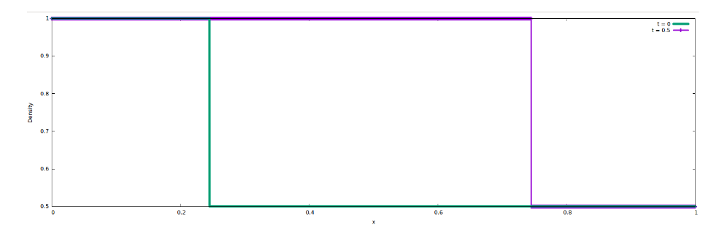
The expected result
The exact solution to this initial data is known, the initial density discontinuity should just propagate to the right
We attempt to simulate this using our four-equation model

Slide 26
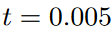
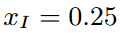
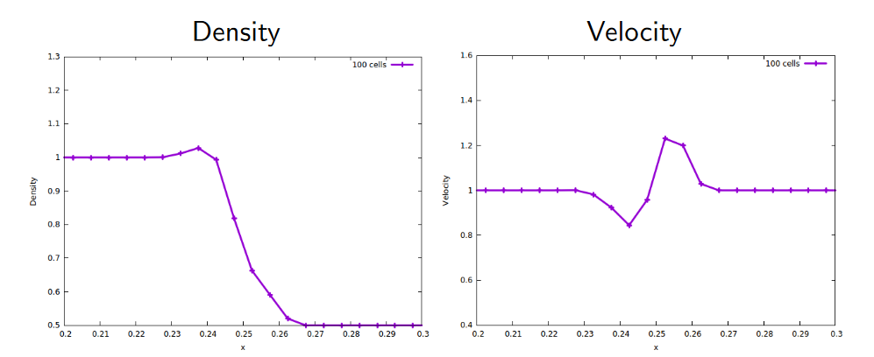
After a very short time…
Density and velocity are plotted after t = 0.005, the evolution should have moved the interface to xI = 0.25
Unphysical oscillations are seen - it is possible that they will decrease with increased resolution though.

Slide 27
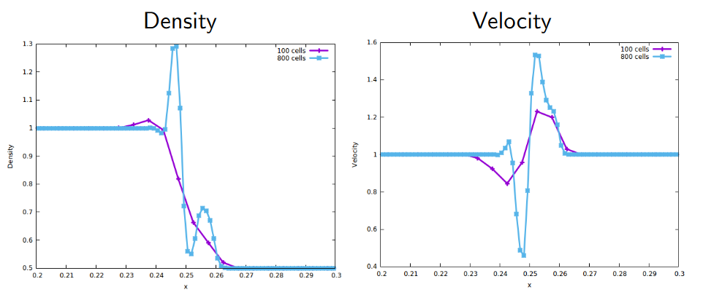
After a very short time…
We re-run the test case with 800 cells, compared to 100 cells for the original run
The oscillations are not converging (in fact, the 800 cell simulation crashed shortly after this point)

Slide 28
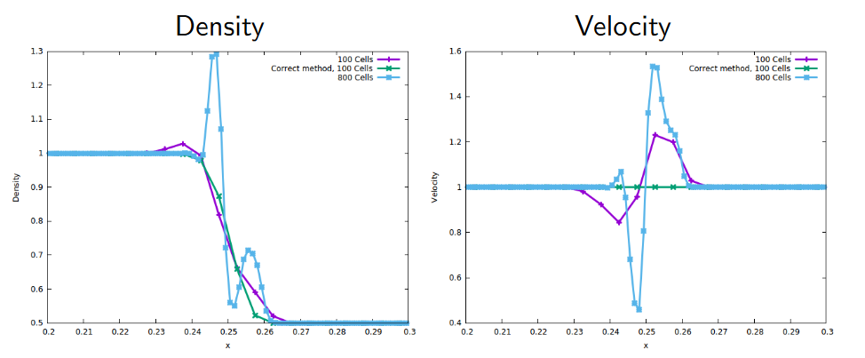
After a very short time…
The growth of oscillations with resolution demonstrates an instability; something has gone wrong
We can plot the result using a successful numerical method in green; we see the expected smearing, but no oscillation and a perfectly smooth velocity profile

Slide 29
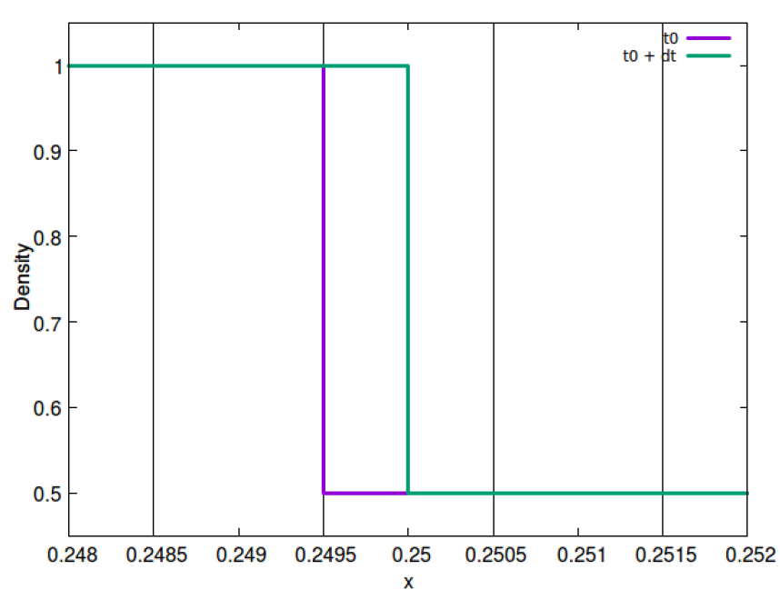
Why does this approach fail?
By allowing the equation of state to smear, we make the assumption that the ideal gas coefficient for a mixture of our two materials is an average of each individual coefficient
The results suggest that there are problems with this assumption
In fact, we can show that we have an under-determined system
We can demonstrate this by considering the behaviour at the first time step

Slide 30
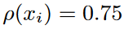
Why does this approach fail?
We consider a case where we have chosen a time step such that our discontinuity has moved half a cell
The exact solution in this case would be the discontinuity reaches
Under the finite volume representation, we would not see this, of course
Instead we would have

Slide 31
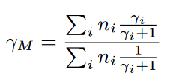
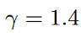
Why does this approach fail?
For a mixture of chemically non-interacting ideal gases, it is possible to determine an adiabatic mixture constant
The materials we have chosen: is air and is a monatomic gas
Both argon and helium are commonly used in experiments
We can also work out the mixture for the evolved cell, using the conserved quantity

Slide 32
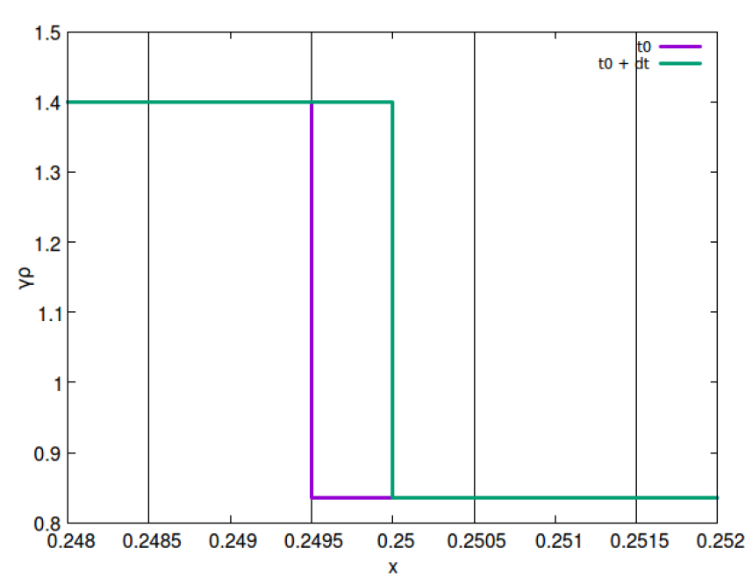
Why does this approach fail?
As discussed, the interface (and hence ) moves with the fluid velocity, and thus has also moved half a cell
Therefore:
Which means we can compute the mixture value,
Does this correspond to the expected mixture value?

Slide 33
Why does this approach fail?
In order to compute the mixture adiabatic index, we need to know the number of moles of material within our volume,
This is where we start to see some issues – we haven’t said which noble gas we are using
This didn’t matter for our model, but it does for reality!
Because argon is heavier than helium, for a given density, we have a different

Slide 34
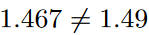
Why does this approach fail?
The mathematical model we constructed gave us an answer, but this was for an underdetermined system
As a result, this result could well be meaningless
If we assume our noble gas is argon, then for this mixuture, we have
Since , this model has clearly been unable to solve for an air-argon interface correctly

Slide 35
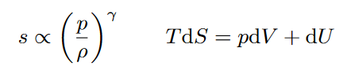
Thermodynamic inconsistency
We have demonstrated that this naive model leads to an incorrect prediction of
In a coupled system, an error in one variable propagates through, causing errors globally
The reason for this is clear, an incorrect value of leads to a spontaneous change in entropy, which, following the laws of thermodynamics, provides unphysical energy input or removal from the system
This is a thermodynamic inconsistency in the underlying equations
This results in the oscillations seen in the simulation
The challenge in any multiphysics method is therefore to achieve thermodynamic consistency at the interface between two materials

Slide 36
Outline
What do we mean by multiphysics?
Methods for multiphysics
Challenges of multiphysics modelling
Multiphysics approaches

Slide 37
Dealing with multiple materials
Multiphysics methods are those that can deal with material interactions whilst maintaining thermodynamic consistency
We shall now give an overview of the methods available, before looking at many of them in detail
First, however, comes a little terminology with how we refer to material interactions, and the methods for simulating them
Material interactions can either be a sharp interface, or a discrete transition (on a continuum scale)
And multiphysics methods can either consider a sharp jump, or a diffuse region
There is not a 1-1 mapping between these though

Slide 38

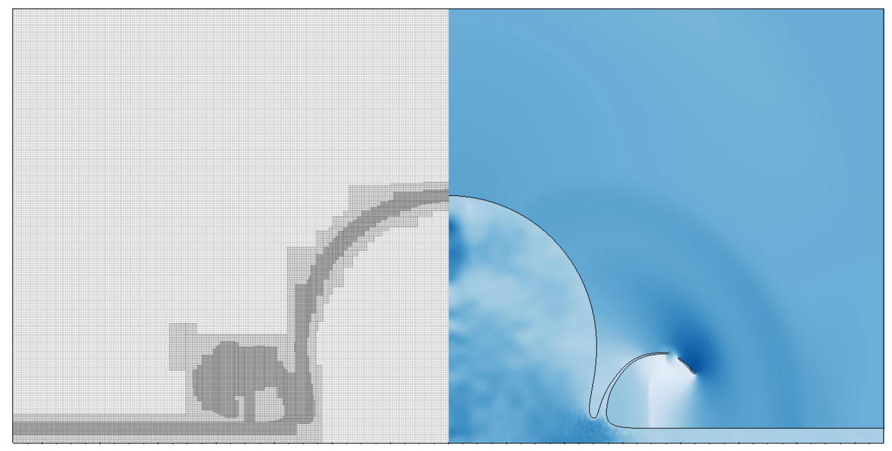
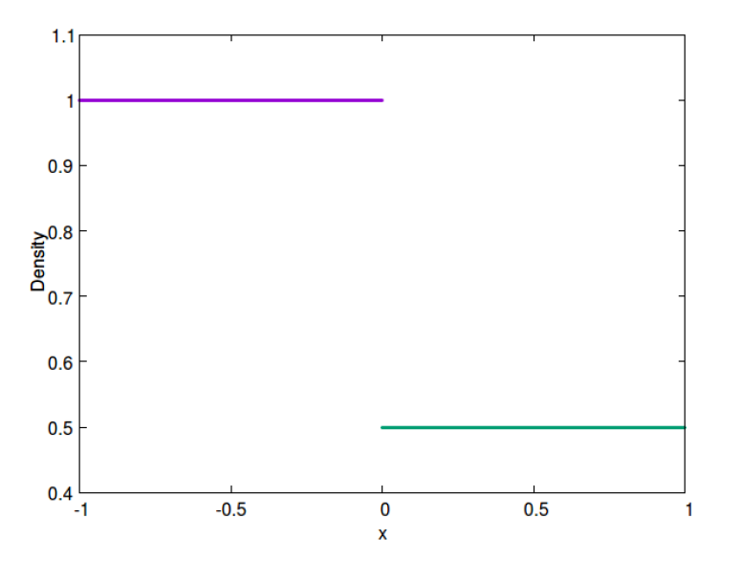
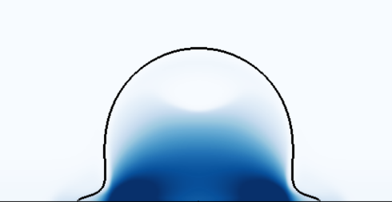

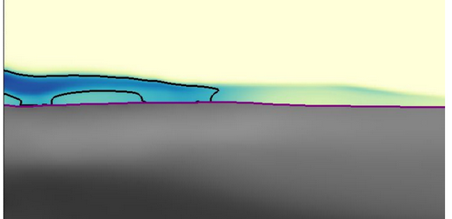
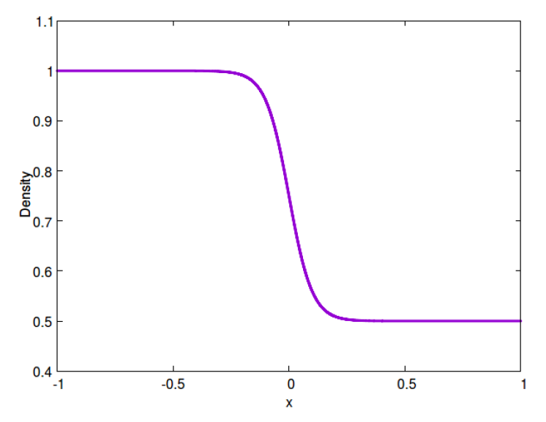
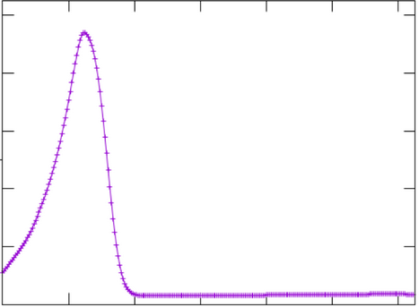
Material interactions
Sharp transition:
Sharp interface method:
?
Diffuse transition:
Diffuse interface method:

Slide 39
Multiphysics methods
Both sharp and diffuse interface methods are widely used
Both have their advantages and disadvantages; their use is often situation-dependent
And both require additional techniques to be implemented on top of our existing models
And part of the reason both are still very successful is that they can be used in extremely complex scenarios

Slide 40
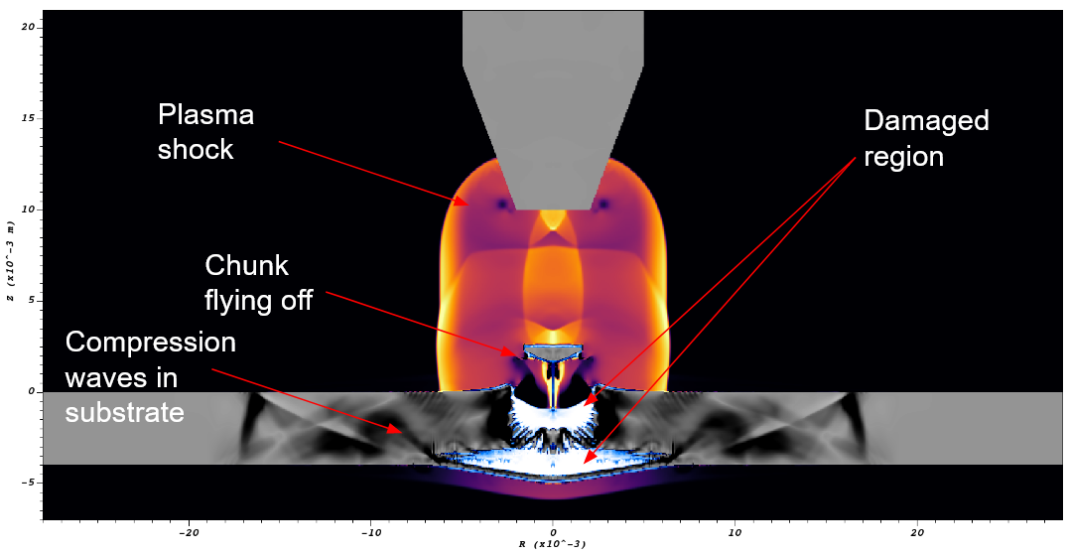
Diffuse interface methods

Slide 41
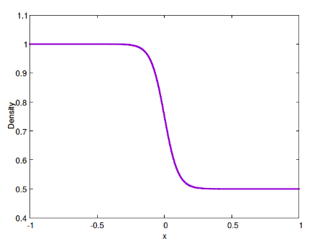
Diffuse interface methods
Diffuse interface methods use a single system of equations to solve multiphysics problems
This then means that there is numerical evolution of what should be a sharp interface, and hence there will be some smearing, i.e. it becomes a diffuse interface
This results in a mixture region; the formulation of the equations is such that this mixture is thermodynamically consistent

Slide 42
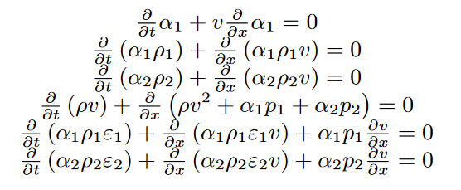
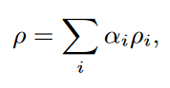
An example diffuse interface formulation
Many different formulations exist, with different numbers of equations; here we have a six-equation model
The amount of material in each computational cell is computed by evolving a volume fraction (or a mass fraction)
Total quantities are computed through mixture rules, e.g. total density
At every point in space, all materials can exist, with their own density, pressure and/or velocity

Slide 43
Advantages of diffuse interfaces
The entire system is solved as a single system of equations – dealing with the material interaction is handled by the formulation
No additional techniques are required to find the interface either, this is part of the formulation
Allowing both materials to exist within a cell means this is a natural approach to deal with material chemistry and phase change; effectively we ‘adjust’ the quantities of each material according to the physics
Forcing terms on the interface, such as surface tension, can be included as source terms for the system

Slide 44
Disadvantages of diffuse interfaces
There are always some terms in the system of equations which cannot be written in conservative form – this requires additional care in choice of numerical method
Dealing with these non-conservative terms may then require additional techniques to be implemented
Because the interface is artificially diffuse, and always spread over more than one cell, there may be situations where this increases error in behaviour at the interface
Each combination of materials requires its own formulation, it may be difficult to move between them (e.g. suddenly incorporating a solid material)

Slide 45
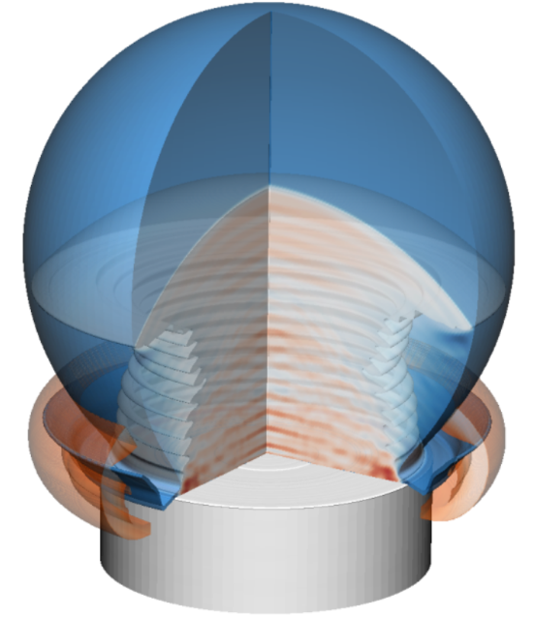
Sharp interface methods

Slide 46
Sharp interface methods
Sharp interface methods model each material within the system with its own system of equations
An additional method is then required to identify where material interfaces exist
This method gives every computational cell a unique material (at a given point in time)
We then need to be able to describe how materials interact with each other

Slide 47
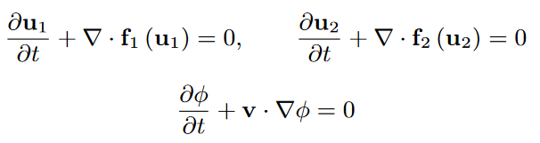
An example sharp interface formulation
Sharp interface methods are a collection of methods, for dealing with materials and their interfaces, which can be pieced together as needed
Each material will have its own system of conservation laws
The location of the material can be evolved by a level set method
Dynamic boundary conditions are applied so that the materials communicate

Slide 48
Advantages of sharp interfaces
The numerical methods for each individual material are straightforward – if you have implemented it by itself, it is ready to use
The methods for each material don’t need to be the same either, whatever was easiest/best to implement
This makes it particularly useful if you need to deal with complex systems of equations, you don’t need to work out how e.g. pressure in a liquid and stress in a solid ‘mix’
Because the interface remains sharp, it is easier to capture fine behaviour along it, especially where you wouldn’t expect mixing to occur

Slide 49
Disadvantages of sharp interfaces
Because each cell contains only one material, and this material can change over time, sharp interface methods are not conservative
This treatment can also lead to a ‘stepped’ appearance to the interface, which can potentially generate additional waves, especially for slow flows
Because each cell contains only one material, there is no easy way to model phase change or mixing – techniques exist but are very complex
You need to be able to describe how any two materials interact – this involves deriving boundary conditions, and you may need to know the characteristic behaviour of your underlying equations

Slide 50
What method is best?
The best method to use depends on your application, the amount of time you have to implement things, and what you feel most comfortable with
For phase change and chemistry, diffuse interface methods will always have the advantage
For fine interface features such as water droplet jetting, or for very complex systems, sharp interface methods have the advantage
And the two methods can be combined, such as the cativating water droplet (diffuse) impacting a metal substrate (sharp)
And advanced techniques, such as material fracture, blend these descriptions to some extent within a single interface

Slide 51
What else is there
In this course, we shall cover diffuse interface methods and dynamic boundary conditions for sharp interfaces (ghost fluid methods)
There are other options, which we don’t have time to go into
Volume-of-fluid methods – an alternative technique to locating the material interface – can be harder to find interface properties, but common in older work
Arbitrary Eulerian-Lagrangian methods – attempting to mix the best of both Eulerian behaviour for compression and Lagrangian interface motion – requires understanding of both methods
Multi-material cut cell methods – use the advantages of cut cell methods to describe material interfaces – still a research area and some of the challenges (material break-up) start to become apparent again

